Slide 1
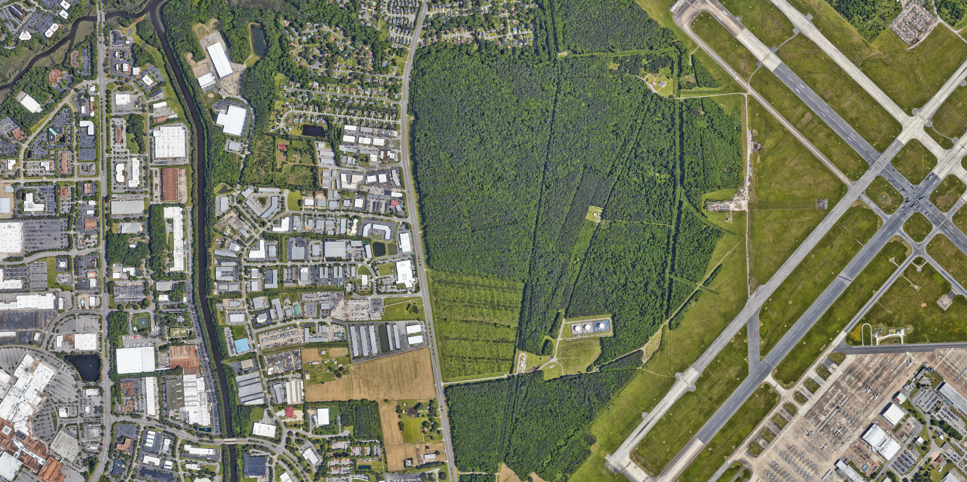
Still
Pond
Big Backwater Creek
Backwater Boulevard
Installation Boundary

