Slide 1
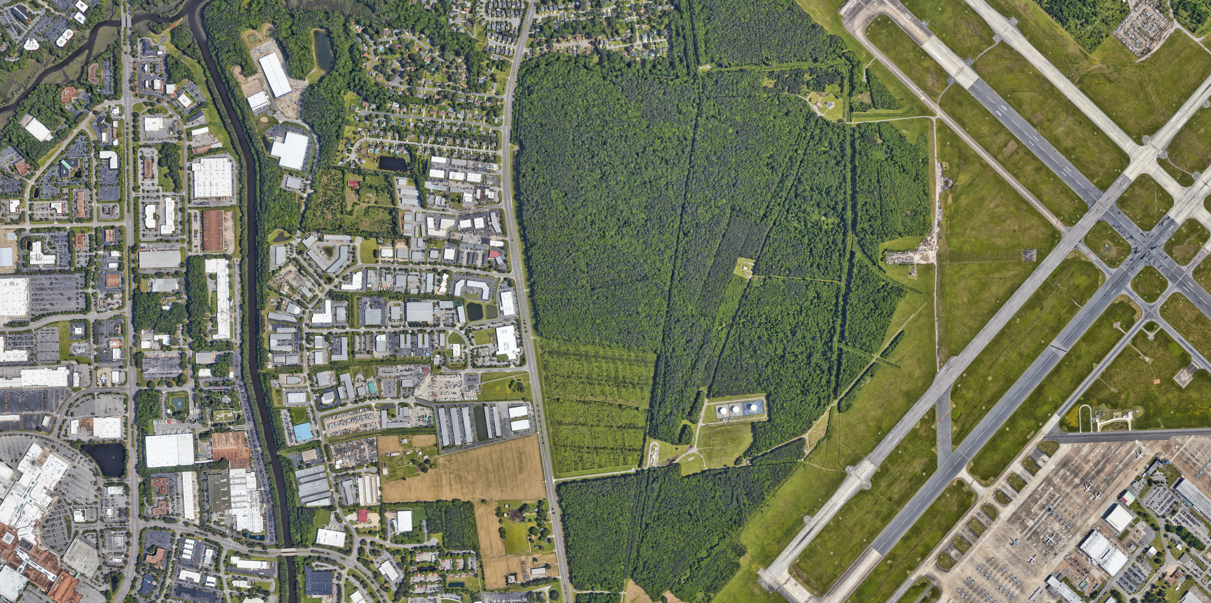
Still
Pond
NAS Backwater
Big Backwater Creek
Backwater Boulevard
Bulk Fuel Farm
Installation Boundary
CITY OF BACKWATER

